Slide 1

Lonavala House
price predictor
Machine Learning Based Real Estate Price Estimation
Presented by: Vishal Verma

Slide 2


Problem Statement
Imagine a person planning to buy or sell a house in Lonavala — a popular and high-value real estate location.
The first and most important question they face is:
What is the correct price of this property ?
In reality:
Property prices are often decided through rough estimation
Different brokers may suggest different values
Market trends keep changing
There is no instant and reliable way to calculate fair value
As a result, Buyers may pay too much, sellers may sell too low, and investors may make wrong decisions.
Therefore, there is a need for a data-driven system that can estimate house prices accurately and instantly.

Slide 3

Proposed Solution
To address this challenge, this project introduces an intelligent price prediction system.
The system:
Learns from historical property data
Identifies the relationship between area and price
Builds a predictive model
Generates instant price estimates
The User :
The user simply enters the property area, and the system calculates the expected price automatically.
This removes guesswork and brings data-based decision making into real estate valuation.

Slide 4
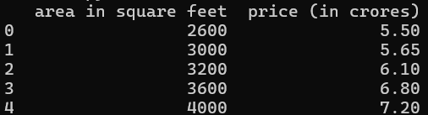
Dataset Overview
For the model to make accurate predictions, it must first learn from past data.
The system is trained using historical property records containing:
Here:
Area is the input (Feature)variable
Price is the output (Target)variable

Slide 5

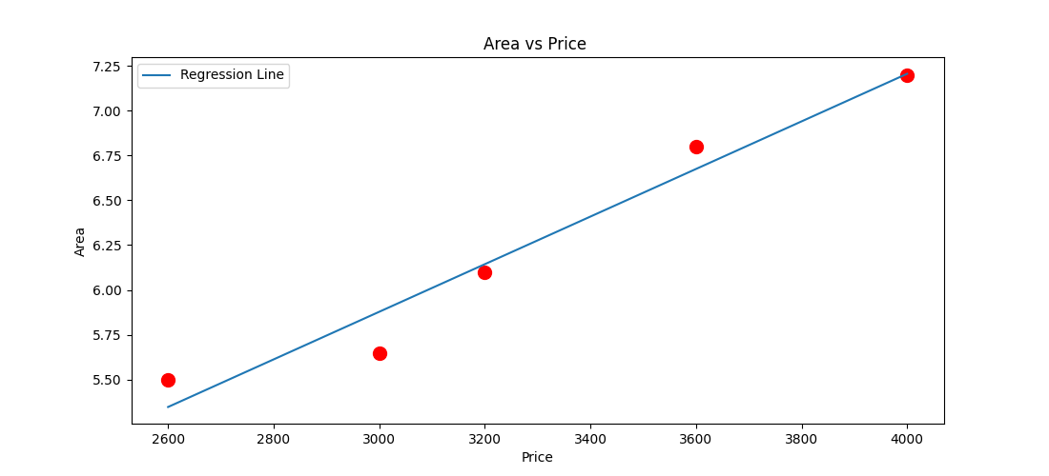

Pattern / Graph
After analyzing the dataset, the model identifies a clear pricing trend between property area and market value.
Graph Explanation:
• Each red dot represents an actual property from the dataset
• The straight line represents the Linear Regression line
→ It is the best-fit line calculated by the model
Price $430
Price $540
What Does the Regression Line Show?
• It represents the overall pricing trend
• It shows how price changes as area increases
• It gives predicted price values for any given area
We observe a positive linear relationship: -->As the area increases, the price also increases in a consistent pattern.
Understanding Accuracy:
• If a data point is close to the regression line → Prediction is more accurate
• If a data point is far from the line → Prediction error is higher
The regression line is drawn in such a way that it minimizes the total error between actual prices and predicted prices.

Slide 6
Tech Stack & Target Users
Tech Stack Used :-
component | Tool | Purpose/Role
Data handling | Pandas | Load and manage property dataset
Visualiziation | Matplotlib | Plot area vs price graph & show regression line
Model Training | Scikit-learn | Build Linear Regression model
GUI Development | Tkinter | Create user-friendly interface for predictions
Target Users :-
🏡 Homebuyers –Helps buyers know if the house price is right according to the area.
🏢 Sellers / Real Estate Agents –Helps them fix the correct and competitive selling price.
💰 Property Investors –Helps them compare properties and choose the best one for investment.

Slide 7
How Prediction Works
Step 1: User Input
The user enters the property area (in square feet) in the system.
Step 2: Model Uses Learned Pattern
The Linear Regression model has already learned the relationship between area and price from past data.
Step 3: Price Calculation
The model applies the mathematical formula & calculates the estimated house price.
Step 4: Display Result
The predicted price is shown instantly on the screen through the GUI.

Slide 8
